Slide 1

INSTITUTE OF AERONAUTICAL ENGINEERING
(Autonomous)
Dundigal, Hyderabad - 500 043
EXEED- Project Based Learning Prototype Submission Format
1. Student Details
Name of the Student | Roll Number | Branch | Mobile Number
G SRUJANKUMAR | 20951A3353 | CSIT | 9949721349
P SUMANTH | 20951A3354 | CSIT | 9381582790
2. Title of the Innovation or Prototype
Automatic Plant Moisture Monitoring System
3. Define the problem and its relevance to today's market / society / industry need (Max: 100 Words)
Planting a tree in an environment where the seed or the plant would not get water adequately through natural sources like rain or ground water in its initial phases has been always a matter of concern for tree planters. Water pays key role. Here the main problem is knowing moisture of soil where the is planted.
Describe the Solution / Proposed / Developed (Max: 100 Words)
This system timely monitors the moisture level of the soil. If at the time of monitoring it comes to know that the moisture level of the soil is lower than recommended then it will automatically starts water pump.
5.Explain the uniqueness and distinctive features of the (product / process / service) solution (Max: 100 Words)
In this system we use A moisture level sensor is used to detect the moisture level of the soil. And we use Arduino and relay module to on/off the water pump.

Slide 2
6.How your proposed / developed (product / process / service) solution is different from similar kind of product by the competitors if any (Max: 100 Words)
We have used a relay module and Arduino to automate water pump based on moisture level of soil. The main feature of the system is automated so it makes work easier.
7.Utility: Highlight the utility/value proposition (key benefits) aspects of the solution/innovation* (Max: 100 Words)
As the system is automated and it costs low with Arduino .It is very useful to the farmers and it costs around 2000 in Indian currency.
And it is very useful in houses also because of automated plants will not die due to scarcity of water.
8.Scalability: Highlight the market potential aspects of the Solution/Innovation (Potential Market Size, segmentation and Target users/customers etc.) (Max: 100 Words)
Planting a tree in an environment where the seed or the plant would not get water adequately through natural sources like rain or ground water in its initial phases has been always a matter of concern for tree planters. Water pays key role. Here the main problem is knowing moisture of soil where the is planted.
This system timely monitors the moisture level of the soil. If at the time of monitoring it comes to know that the moisture level of the soil is lower than recommended then it will automatically starts water pump.
As the system is automated and it costs low with Arduino .It is very useful to the farmers and it costs around 2000 in Indian currency.
And it is very useful in houses also because of automated plants will not die due to scarcity of water.

Slide 3
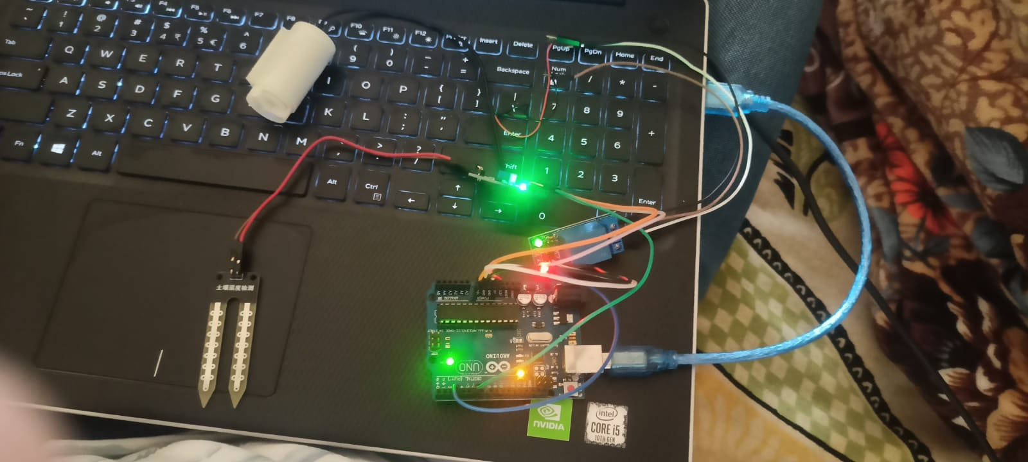
Economic Sustainability: Highlight commercialization/business application aspects of the solution (how it is going to economic profitable and viable) (Max: 100 Words)
In India it is well known that the population is very high.so India needs large amount of food production.so huge amount of land is used for agriculture our system is very useful for agriculture.so our system definitely gets economic profitable.
10.Environmental Sustainability: Highlight environmental friendliness aspects and related benefit of the solution/innovation (Max: 100 Words)
Planting a tree in an environment where the seed or the plant would not get water adequately through natural sources like rain or ground water in its initial phases has been always a matter of concern for tree planters. Water pays key role. Here the main problem is knowing moisture of soil where the is planted.
In India it is well known that the population is very high.so India needs large amount of food production.so huge amount of land is used for agriculture our system is very useful for agriculture.so our system definitely gets economic profitable.
11.Details of Prototype
Components | Arduino UNO 5 Volt Relay Module Soil Moisture Sensor Jumper Wires Water Pump and tube/pipe
Budget | 2231.05(In India)
Video Link | https://drive.google.com/file/d/1Z_f7jWLIUqxCK7fBxcNfY05LT1Q7-dSH/view?usp=share_link
Image of prototype:
Signature of the PBL faculty In-charge

